Slide 1
Sign-Aid
A real time mobile app for sign language prediction and translation

Slide 2
ARCHITECTURE
A front end interface in React which sources upon three different REST APIs lying at the backend through Flask embedded with our deep learning models, each having its own unique interface in React.
The entire existing architecture has been explained in the following slides.

Slide 3
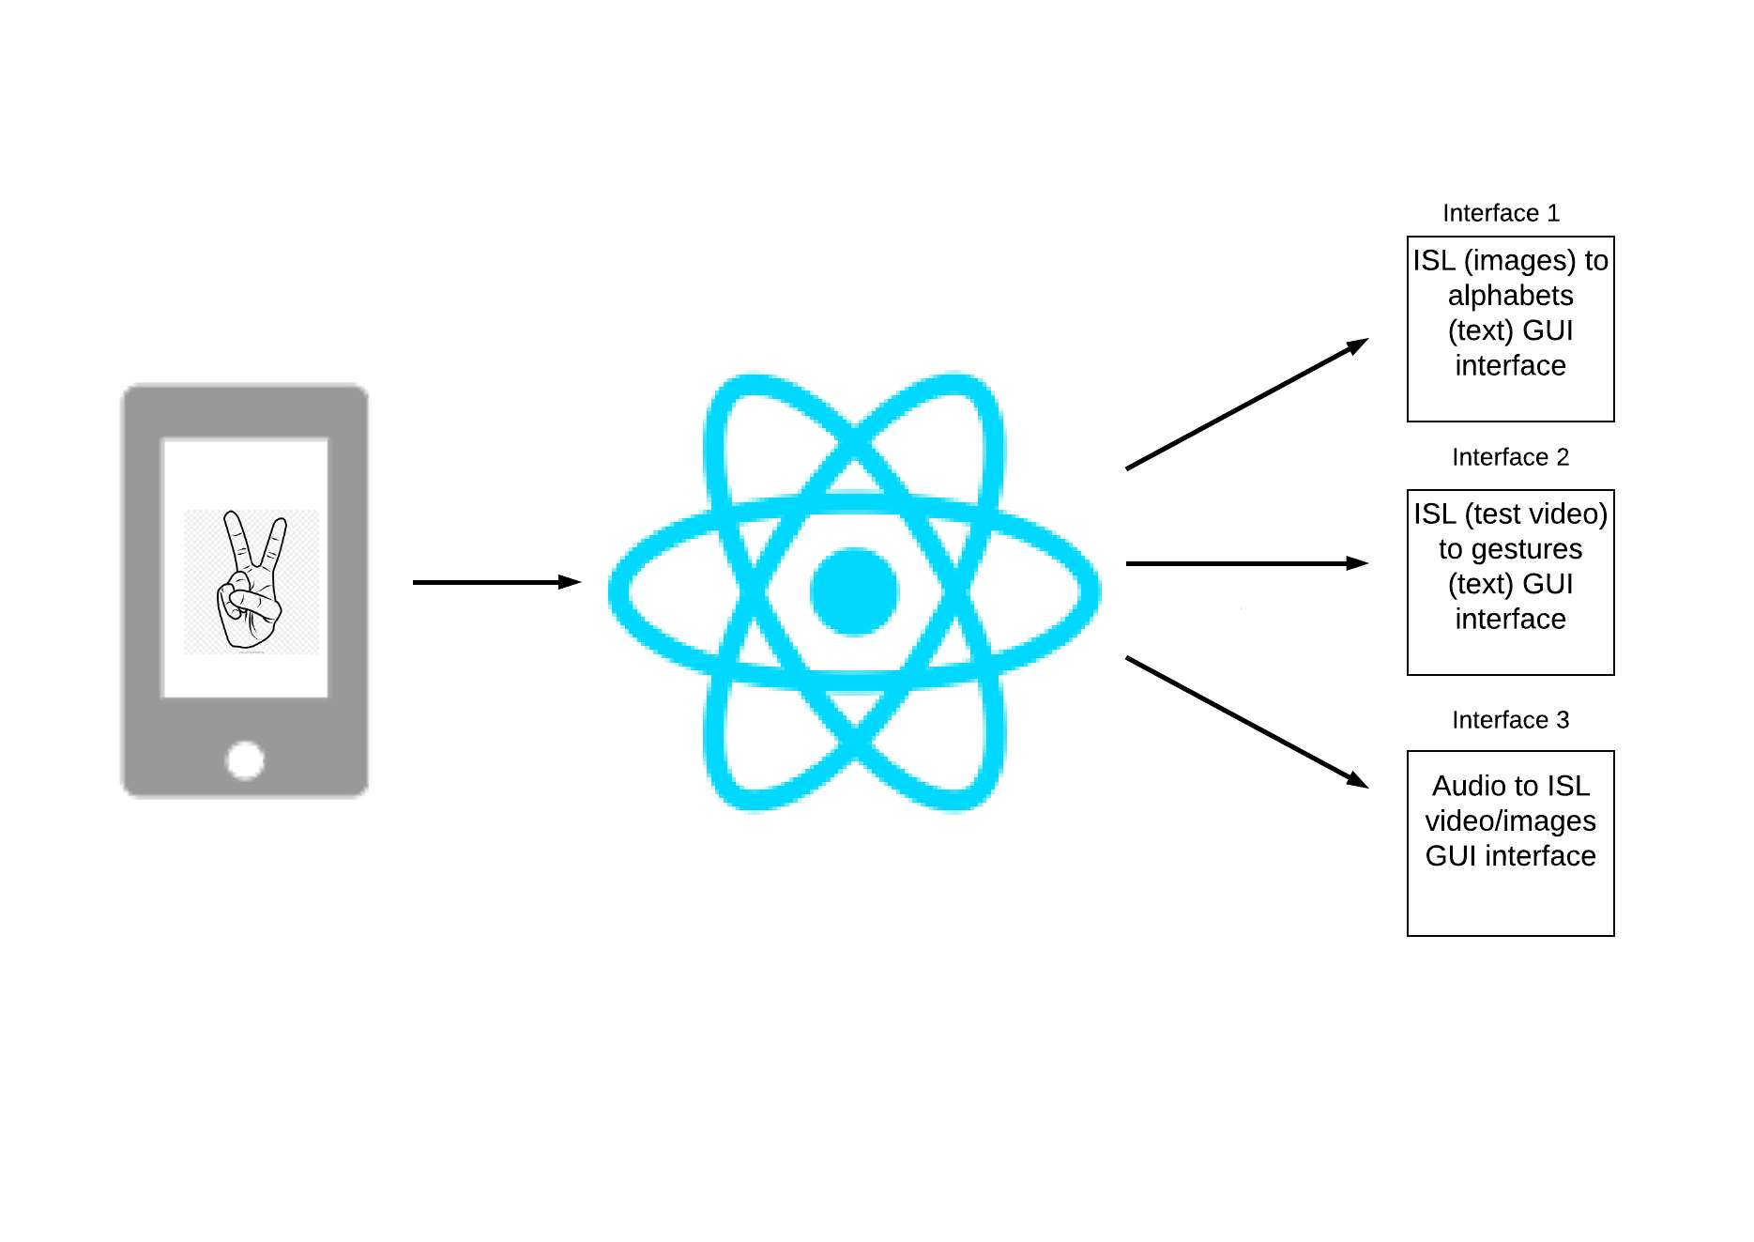
Design Architecture

Slide 4
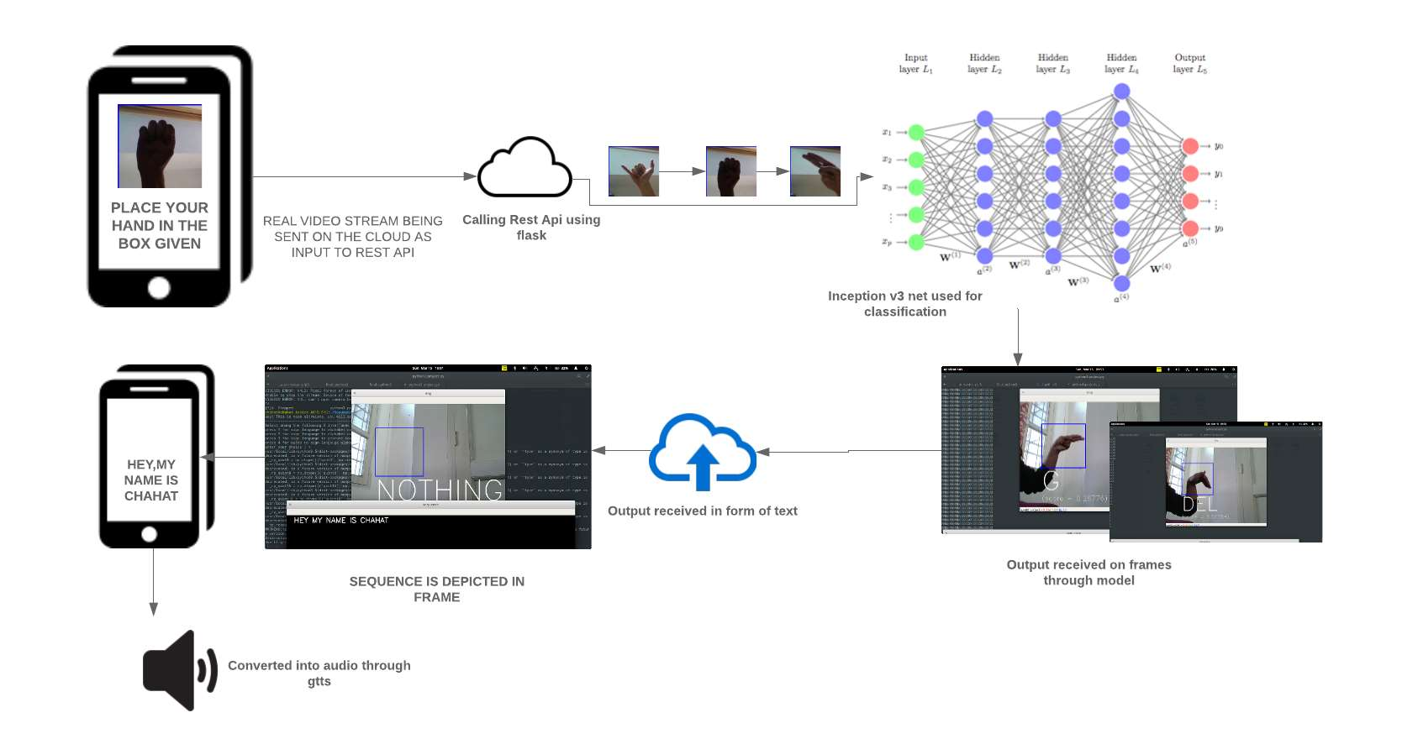
Interface 1

Slide 5
Interface 1: ISL (images) to alphabets (text) Model architecture
In the first interface, initially, the position of the user’s hands captured in bounding box is taken in the form of image streamed in real time. A series of the real time frames is being fed to the model.
The classification model has been trained on 26 alphabets and 3 additional gestures(3000 images for each) i.e. nothing, space and delete. The model follows the architecture of Inception ResNet v3. The output of the model is in the form of text that is being fed to the front end through our server.
Each frame gives an alphabet which is being appended to the sequence printed and converted to speech through GTTS at the end of the processing of all the real time frames.

Slide 6
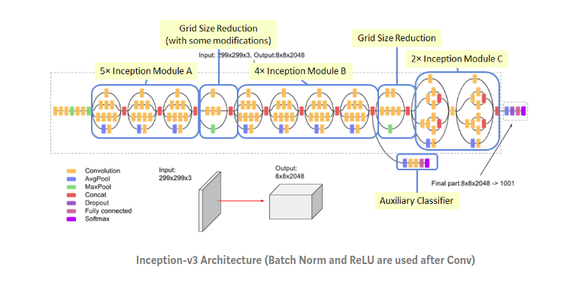
Model Insight(Inception Resnet V3 Architechture)

Slide 7
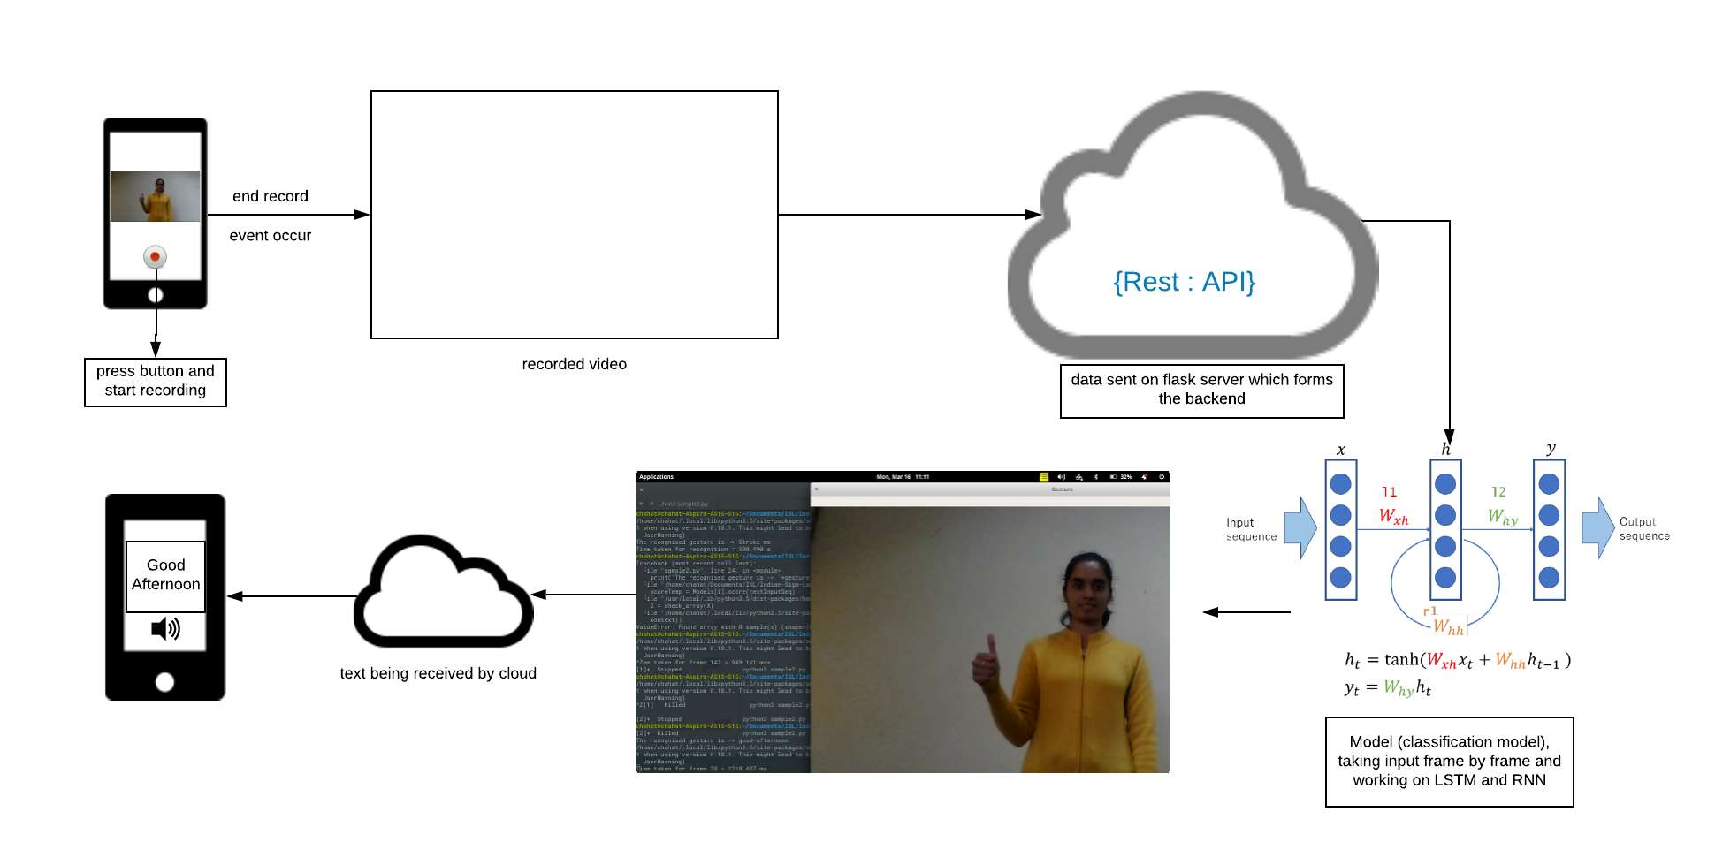
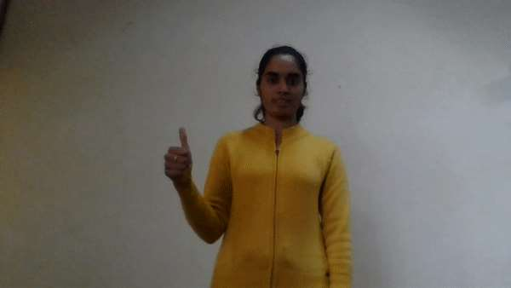

Interface 2

Slide 8
Interface 2: ISL (Videos) to alphabets/gestures (text) Model architecture
This API seeks upon taking a recorded video taken through the react interface and providing it to the server at the backend.
The server seeks upon feeding the video in our deep learning model which is based upon the LSTM network as it learns through RNN to identify gesture by storing the hand movements retrieved from each frame of the provided video dataset(It has memory) trained on 2600 videos 100 belonging to each gesture.
The output of this model is provided to the server which communicated with the frontend in order to show the results.
The result such as ‘good-afternoon’ is then converted into audio using gTTs, a google text to speech API.

Slide 9
Model Insight( RNN and CNN)
The training of the model is done through following architecture:
Extract frames from gesture videos
Training of frames on Inception resnet V3 model
Each Video is represented by a sequence of n dimensional vectors (probability distribution or output of softmax) one for each frame. Here n is the number of classes.
Train the RNN model on the softmax based representation of gestures for 10 epochs and save the model.
Predict the labels of the softmax based representation of the test videos.Predictions and corresponding gold labels for each test video will be displayed.

Slide 10
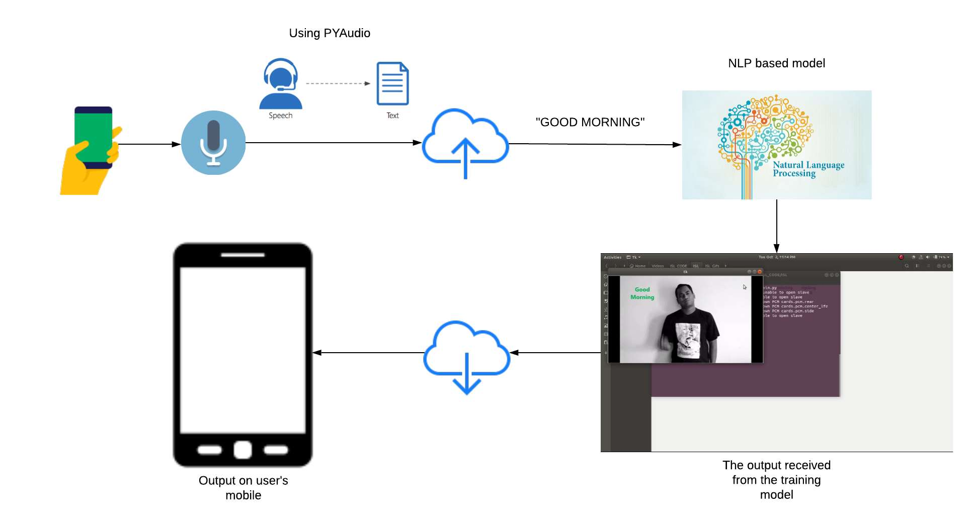
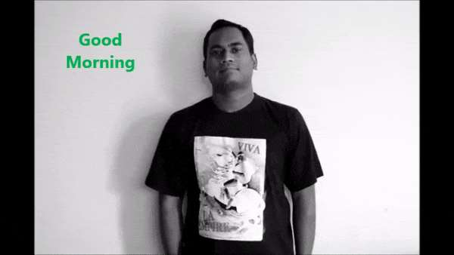
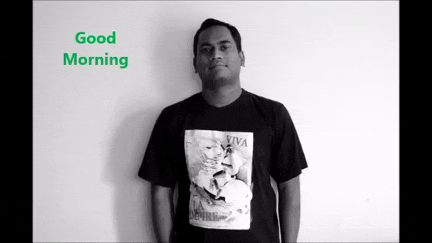
Interface 3

Slide 11
Interface 3: Audio to gestures(video) GUI Interface
This model is based upon taking Speech as input through microphone using PyAudio, an open source interface based upon converting speech into text. The Speech recognition using Google Speech API.
The input text is processed through a natural language processing model based on a sequences (preserves word order) representation and the output in form of an optimized text is received through appropriate classifier.
To each input text we have a corresponding video of a word/ image of an alphabet retrieved as we provide the corresponding text taken through simple list structure and operating system operations

Slide 12
USE CASE
Communication has become an important part of an individual’s growth and we believe everyone should have an equal opportunity for this. This app provides a platform which can bridge the communication gap between those who use sign language and those who don’t know sign language.
There are various situations in daily life that might require interacting with people who use sign language as primary mode of communication such as people with hearing and visual impairments. The app simplifies this communication process by converting speech into gestures and also gestures into text and speech in real time.

Slide 13
In malls and various showrooms, sometimes people who know sign language are specially employed so that customers with hearing or visual impairments do not face any difficulty. In order to decrease company costs and save humanpower this product can be used to guide the customers with special needs.
Even basic daily tasks such as placing order for food at restaurants or getting some administrative work done becomes very cumbersome for people with hearing and visual impairments all because of inability to communicate properly and if the app is used in situations like these, it can facilitate easy and effective communication thereby simplifying basic daily tasks.

Slide 14
Business Case
People with visual and hearing impairments have difficulty in communicating using sign language, our app strives to solve this problem. We aim at publishing our app on Google Play Store and Apple App Store, which will require an initial investment of $160(₹11,800). This amount is broken down into : $25 one-time payment for publishing app on Google Play Store, $99 for publishing the app on Apple App Store for a year, $3 for using AWS for web app hosting and $33 variable costs (for maintenance purposes). The app will work on a subscription model wherein the payments would be made quarterly. The tentative price kept for each quarter is $1.22 (₹90). Estimating that there will be 20 new users for the app in each quarter and 5 users would stop using the app every quarter, the break even would be achieved within 10 months.
(The above currency conversion rate is subject to change with market
fluctuations).

